Slide 1
Seattle
With Kodiak West Travel

Slide 2
And if you can spare one more day…

Slide 3
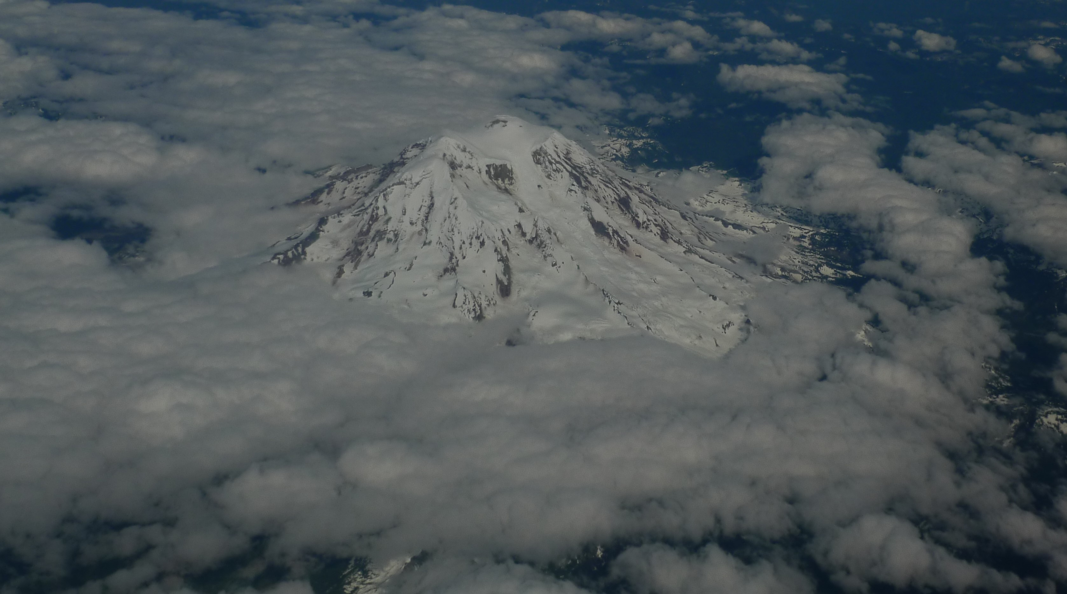
Visit Mt. Rainier National Park!

Slide 4
Visit Seattle Before or After Your Cruise to Alaska!
Kodiak West Travel Can Help You Develop Your Itinerary

Slide 5

Although cruises to Alaska are held during summer months, a visit to Seattle in summer is no guarantee of sunshine! Keep your favorite umbrella handy!

Slide 6
Day One Sample Itinerary
Get an early start!
Pike Market for breakfast and shopping
Olympic Sculpture Park and a stroll along the waterfront
Mid-afternoon
The Seattle Aquarium
Evening
Seattle Underground Tour

Slide 7
Seattle Weather
Heavy rain in January to May and October to December
Average yearly precipitation is 37 inches
Average temperature in July and August is 75 degrees

